Slide 1
Digital Portfolio
STUDENT NAME : MOHAMMED IMRAN A
REG NO & NMID : 31924U18013
EMAIL : mohammedimranat@gmail.com
DEPARTMENT : B.Sc COMPUTER SCIENCE
COLLEGE : MU College Autonomous/
Thiruvalluvar university

Slide 2
PROJECT TITLE
HOME
ABOUT
SKILLS
PROJECTS
CONTACT

Slide 3


AGENDA
Problem Statement
Project Overview
End Users
Tools and Technologies
Portfolio design and Layout
Features and Functionality
Results and Screenshots
Conclusion
Github Link
3/21/2024 Annual Review

Slide 4

PROBLEM STATEMENT
1. Lack of Clear Organization
2. Inconsistent or Incomplete Content
3. Limited Visual Appeal / Design Issues
4. Difficulty in Demonstrating Skills & Growth

Slide 5

PROJECT OVERVIEW My portfolio is a collection of my skills, projects, and achievements that highlight my learning journey and professional growth. It serves as evidence of my abilities and reflects both my academic and practical experiences. The portfolio is organized to showcase my strengths, creativity, and problem-solving approach. It includes details of completed projects, skills gained, and key accomplishments, presented in a clear and structured way. The aim of my portfolio is to demonstrate my capabilities to teachers, employers, or clients, and to provide a comprehensive view of my personal and professional development.

Slide 6

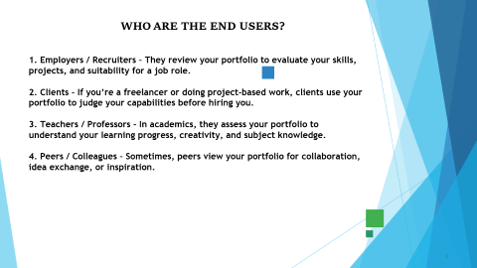
WHO ARE THE END USERS? 1. Employers / Recruiters – They review your portfolio to evaluate your skills, projects, and suitability for a job role. 2. Clients – If you’re a freelancer or doing project-based work, clients use your portfolio to judge your capabilities before hiring you. 3. Teachers / Professors – In academics, they assess your portfolio to understand your learning progress, creativity, and subject knowledge. 4. Peers / Colleagues – Sometimes, peers view your portfolio for collaboration, idea exchange, or inspiration.

Slide 7

TOOLS AND TECHNIQUES Vs code Language Html Css Java Script

Slide 8
POTFOLIO DESIGN AND LAYOUT
Portfolio design and layout play a crucial role in presenting creative work in a professional and impactful way. A well-structured portfolio not only highlights skills and achievements but also reflects an individual’s personal brand and style. Effective portfolio design ensures balance between aesthetics and functionality, using principles of layout such as alignment, hierarchy, spacing, and consistency to guide the viewer’s attention.
8

Slide 9
FEATURES AND FUNCTIONALITY
Visual Appeal – Clean, consistent layout with balanced use of typography, colors, and images to create a professional first impression.
Organization & Navigation – Clear structure with well-defined sections (about, projects, skills, contact) that are easy to follow.
Interactivity & Accessibility – User-friendly design, responsive across devices, and accessible for different audiences.
Showcasing Work – Highlights best projects with detailed descriptions, visuals, and outcomes to demonstrate skills and creativity.

Slide 10
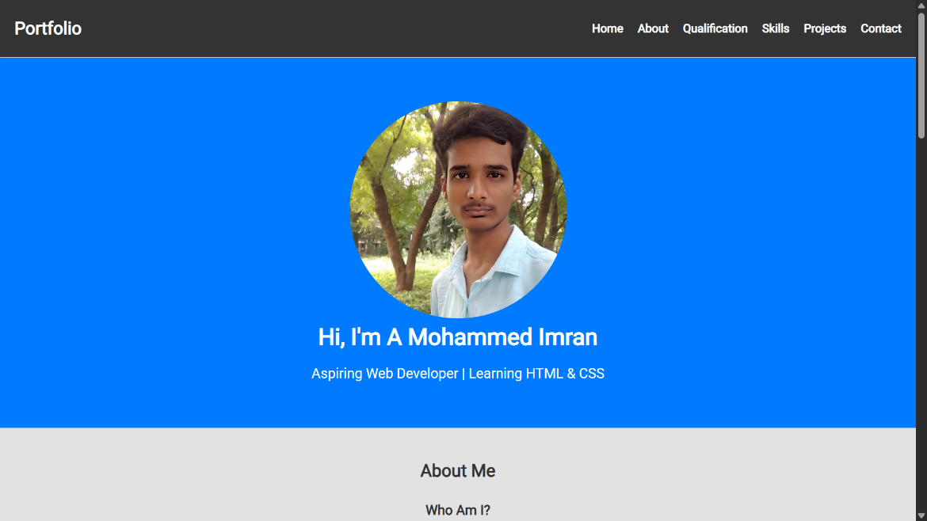
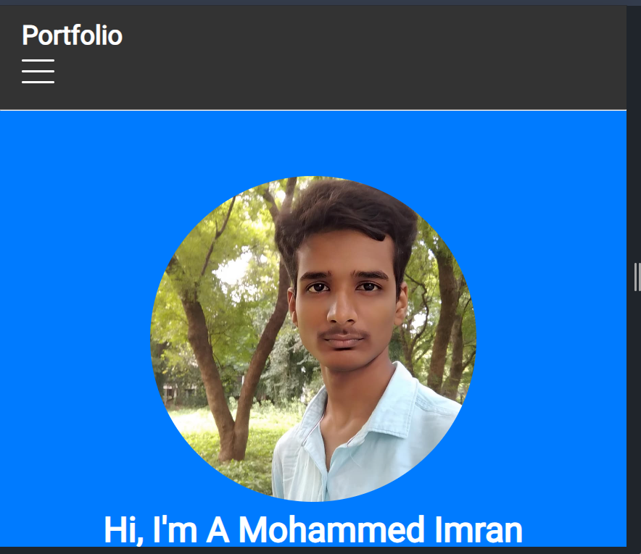
Result and Screenshot

Slide 11

RESULTS AND SCREENSHOTS The results section demonstrates the effectiveness of the portfolio design in presenting work clearly and professionally. Screenshots provide visual evidence of the layout, structure, and user interface in action. They highlight key features, such as navigation flow, project presentation, and overall aesthetics. Together, results and screenshots validate the functionality, usability, and impact of the portfolio.
3/21/2024 Annual Review
11

Slide 12
CONCLUSION A well-crafted portfolio is not just a showcase of work, but a powerful reflection of creativity, skill, and professionalism
12

